Slide 1
Hydrologic Cycle and Precipitation

Slide 2
Lecture Goals
Understand the major components of the hydrologic cycle.
Appreciate the wide variety of precipitation types in various climate regions and lay a foundation for how precipitation affects upcoming topics such as runoff and erosion.
Quantitatively use important concepts such as return period and storm duration.
Discuss precipitation data availability
Key Words: hydrology cycle, precipitation, water balance

Slide 3
What are the components of the hydrologic cycle?

Slide 4
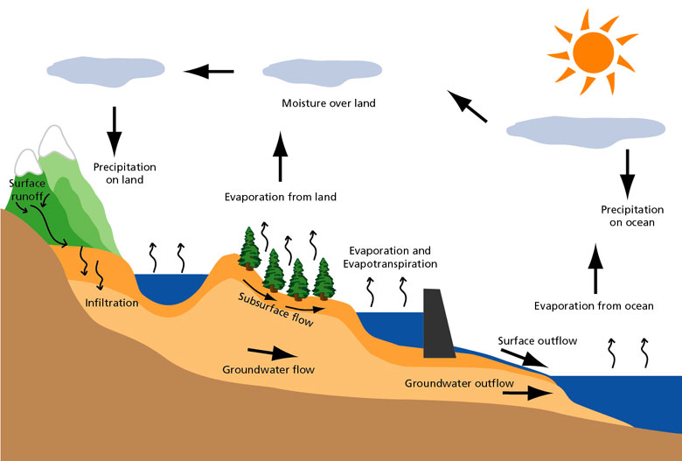
Hydrologic Cycle

Slide 5
Hydrologic Measurements
Want data to help understand weather patterns, help predict future weather, design conservation structures, reduce NPS pollution, etc.
  Precipitation – rain gage and/or snow gage
  Accumulated snow – snow survey
  Runoff – stream gages
  Evaporation – pan, ET w/ lysimeters, sap flow meters
  Groundwater levels – monitoring wells
  Other important meteorological data for modeling and design:
    Wind speed
    Solar radiation
    Temperature

Slide 6
Hydrologic Data
National Oceanic and Atmospheric Administration (NOAA)
  Climate/Weather data
    http://www.noaa.gov/
    http://hdsc.nws.noaa.gov/hdsc/pfds/
    http://www.ncdc.noaa.gov/
United States Geological Survey (USGS)
  Water Quantity
    http://www.usgs.gov/
United States Environmental Protection Agency (USEPA)
  Water Quality
    http://www3.epa.gov/
United States Department of Agriculture (USDA)
  Soils
    http://websoilsurvey.sc.egov.usda.gov/App/HomePage.htm

Slide 7
Hydrologic Data Analysis
Statistics – the science of collecting, summarizing, organizing, analyzing, exploring and interpreting data.
  Plot data
  Descriptive Statistics
    Statistics of location/central tendency
    Statistics of dispersion and variability
  Experimental Error
  Standard Error
  Confidence Intervals
  Probabilities and Distributions

Slide 8
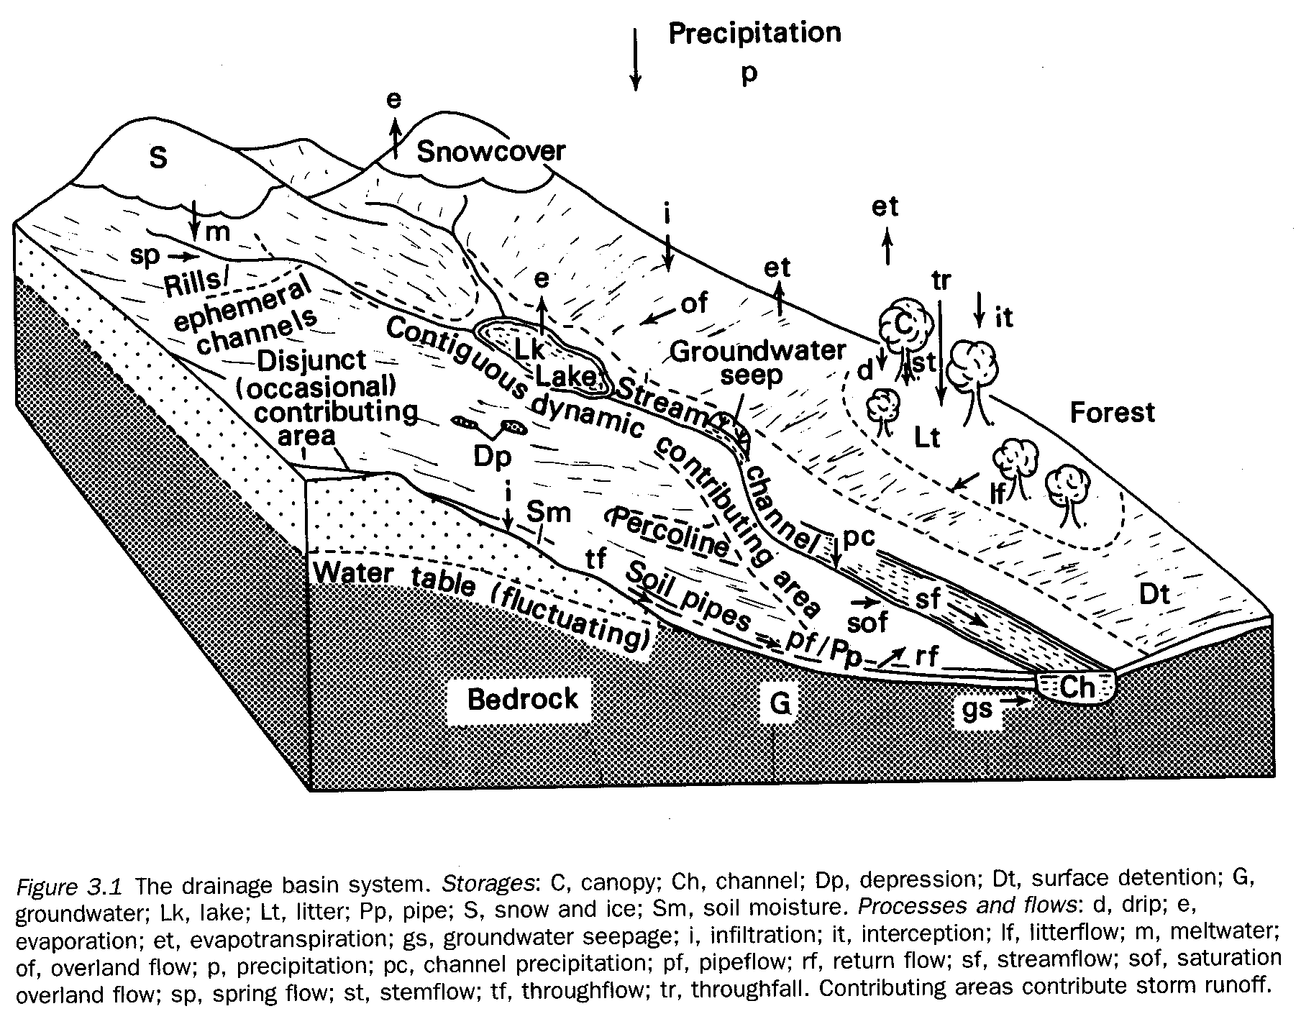
The Drainage Basin as a Flow System
(From Jones 1997)
Runoff = Inputs – Outputs ± ΔStorage

Slide 9
Water Balance
Inputs – Outputs = Change in Storage
Precipitation
Runoff
Subsurface Flow
Irrigation
Evaporation
Transpiration
Runoff
Δ Storage
Water Budget Volumes
  Ft³ (m³)
  Gal (L)
  Acre-feet (ac-ft)
  Inches (cm) over an area
Infiltration
Deep Seepage

Slide 10
Example
How much irrigation is required during the growing season if the crop requires 850 mm of water for optimal production? How many liters of water will be pumped if the field is 10 ha?
Precipitation = 500 mm
Percolation
below root zone
50 mm
Runoff = 15 mm

Slide 11
Solution
Inputs – Outputs = Change in Storage
Inputs = precipitation (500 mm) + irrigation (?)
Outputs = runoff (15 mm) and deep seepage (50 mm)
Change in storage = Water required by plants (850 mm)
(500 + I) – (15 + 50) = 850
Irrigation = 415 mm
Liters of water = 415 mm * 10 ha
= 0.415 m * 100,000 m²
= 41500 m³ = 41,500,000 L

Slide 12
Precipitation

Slide 13
What is precipitation?

Slide 14
Precipitation
Precipitation: water falling from the atmosphere to the earth.
  The primary input into the hydrologic cycle.
  Atmospheric moisture condenses and forms:
    Rain, snow, hail, drizzle, sleet, fog and dew.
  Most precipitation falls as rain.
    Rain has the largest impact on erosion.
  Requires lifting of air mass so that it cools and condenses.

Slide 15
How does precipitation form?

Slide 16
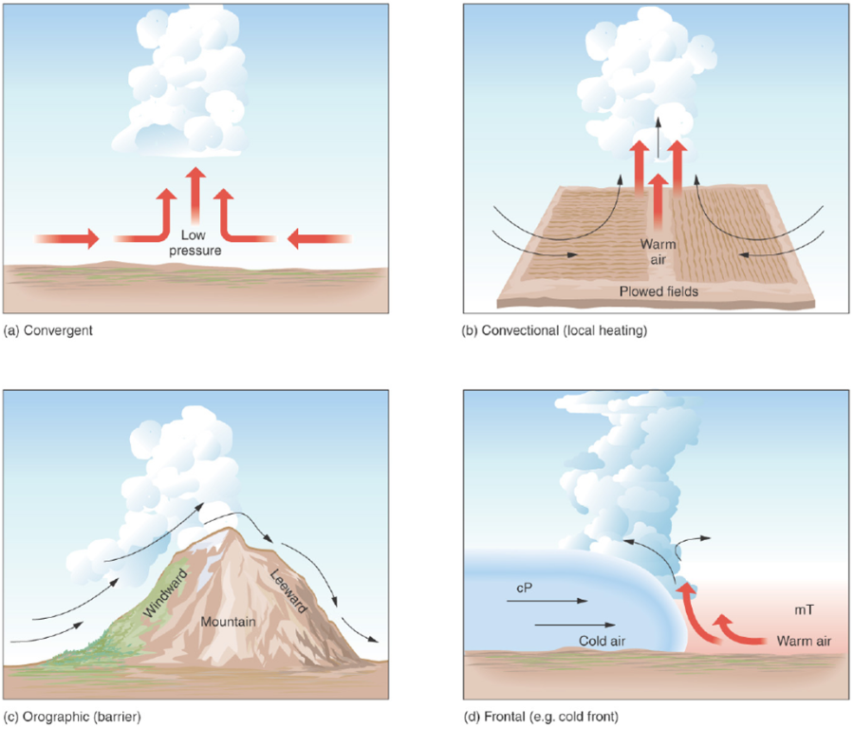
Mechanisms for air lifting

Slide 17
Condensation
Condensation is the change of water vapor into a liquid. For condensation to occur, the air must be at or near saturation in the presence of condensation nuclei.
Condensation nuclei are small particles or aerosol upon which water vapor attaches to initiate condensation. Dust particulates, sea salt, sulfur and nitrogen oxide aerosols serve as common condensation nuclei.
Size of aerosols range from 10⁻³ to 10 μm.

Slide 18

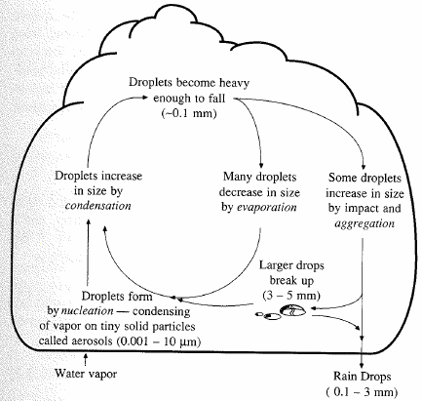
Precipitation formation
Lifting cools air masses so moisture condenses
Condensation nuclei (Aerosols) that water molecules attach to
Rising & growing
  0.5 cm/s sufficient to carry 10 μm droplet
  Critical size (~0.1 mm)
  Gravity overcomes and drop falls

Slide 19
Rain
Raindrops can be as large as 7 mm in diameter.
  Uniform droplets less than 0.5 mm in diameter is drizzle.
The speed of fall depends on the size of the raindrop.
  Terminal velocity, V_{term}=3.86D^{0.67}
Larger raindrops have more energy.
Higher intensity storms typically have larger raindrops.
  Intensity = depth of precipitation / time

Slide 20
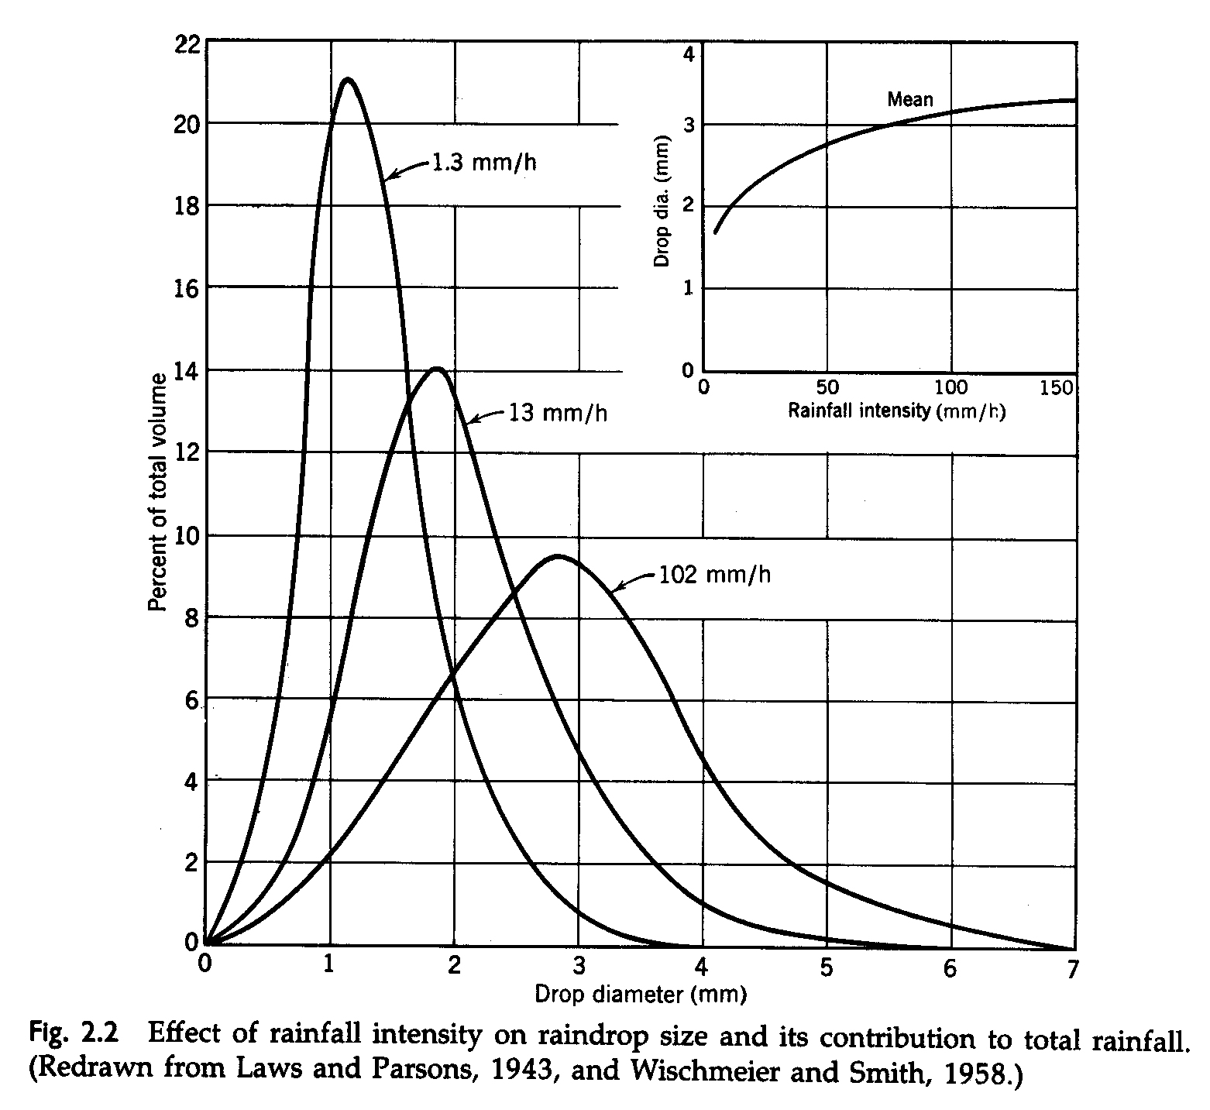

Slide 21
Precipitation Variation
Influenced by
  Atmospheric circulation and local factors
    Higher near coastlines
    Seasonal variation – annual oscillations in some places
    Variables in mountainous areas
    Increases in plains areas
    More uniform in Eastern US than in West

Slide 22
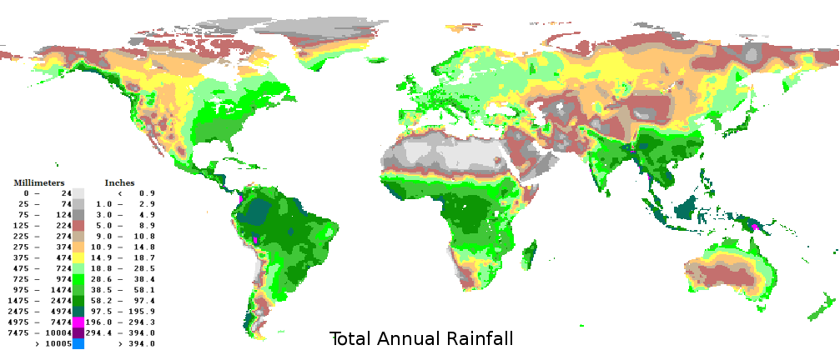
Global Rainfall

Slide 23
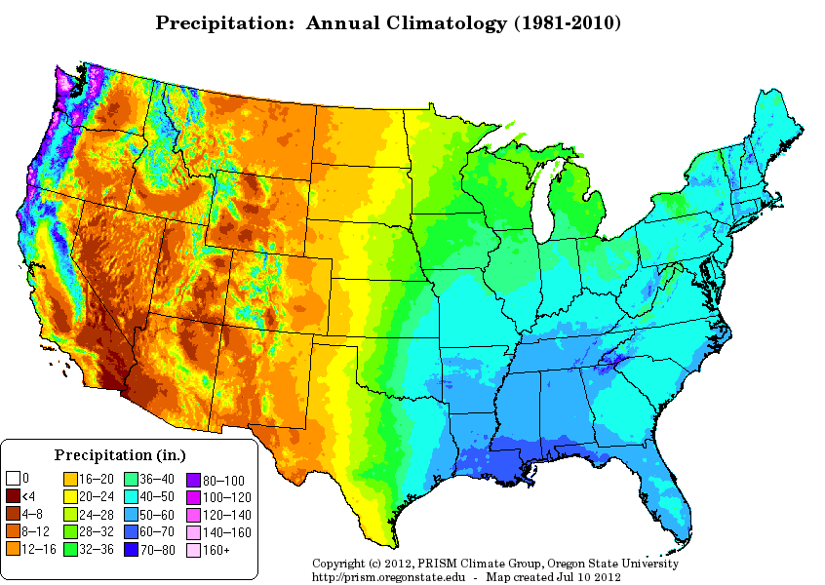

Slide 24
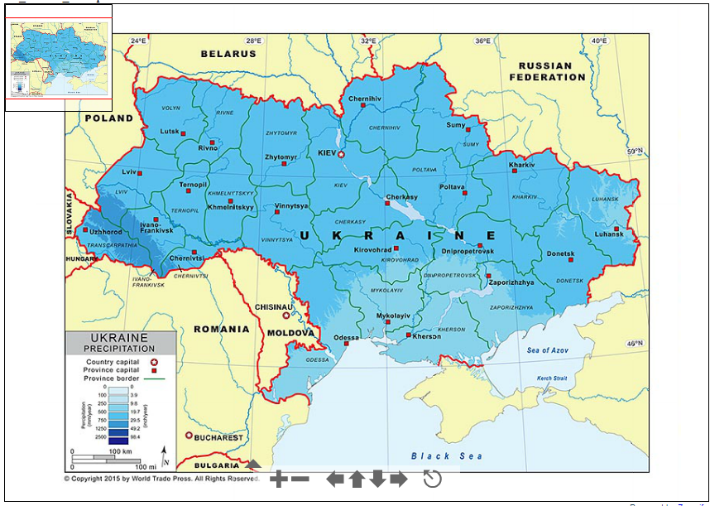
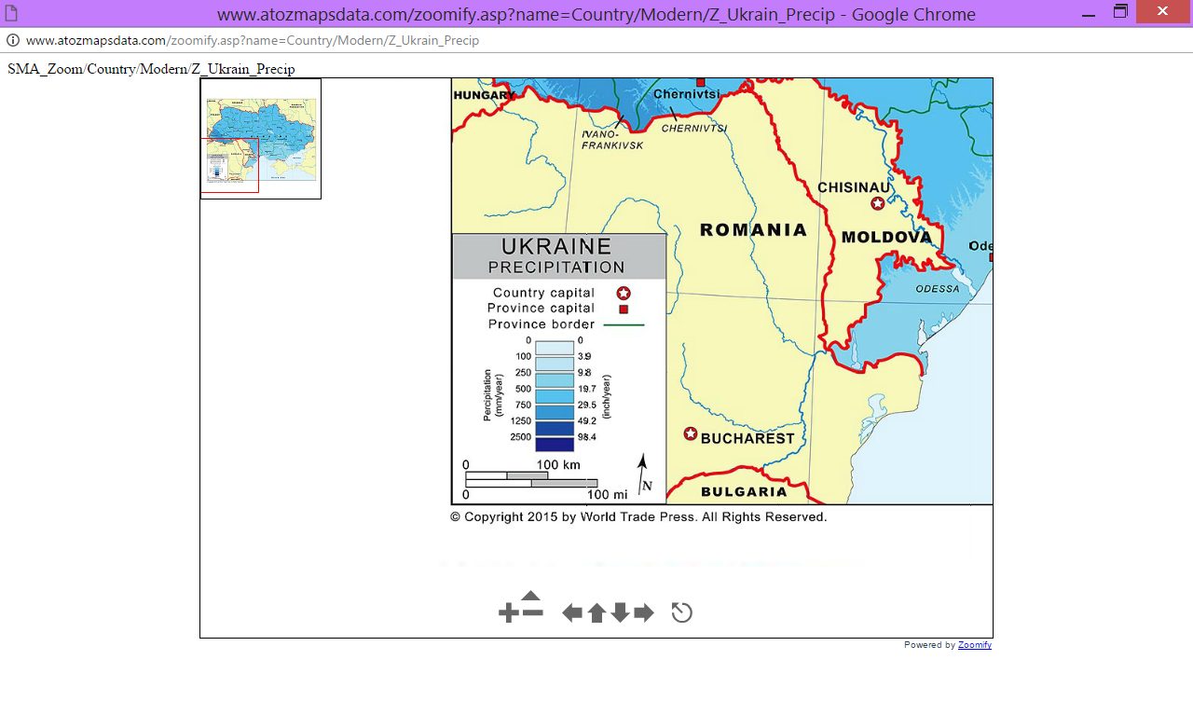

Slide 25
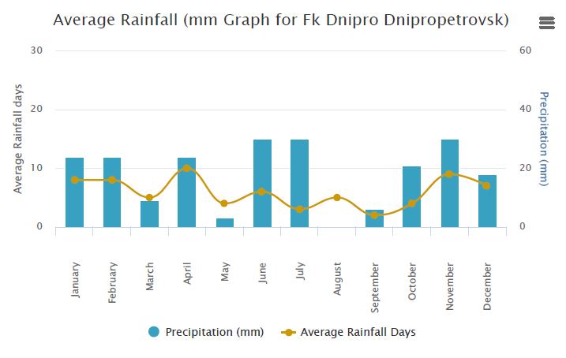

Slide 26
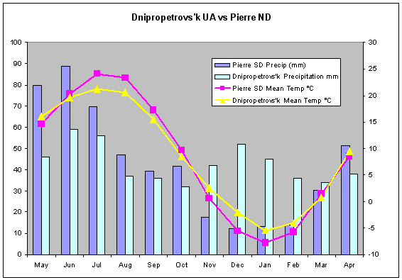

Slide 27
How is precipitation measured?

Slide 28
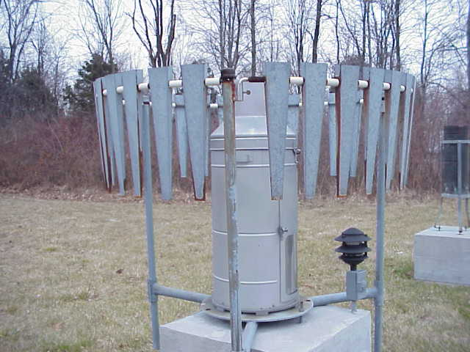

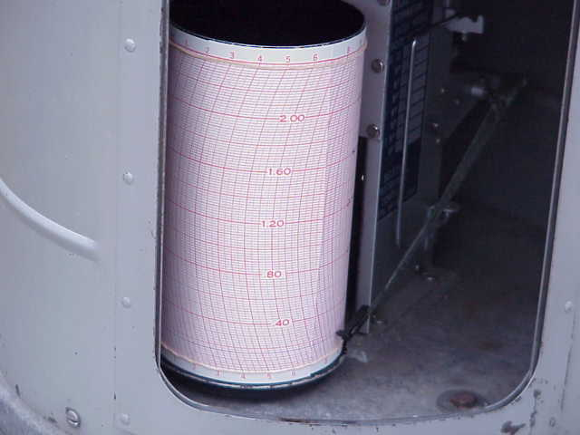
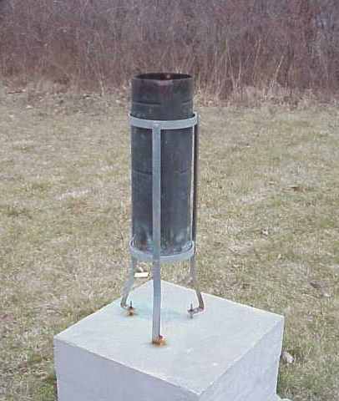
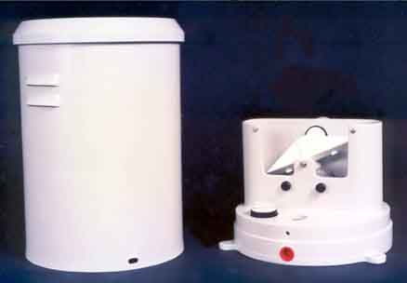

Precipitation Measurement

Slide 29
Cumulative Rainfall
Rainfall Mass Curve

Slide 30
Arithmetic Mean Method
Simplest method for determining areal average
P₁ = 10 mm
P₂ = 20 mm
P₃ = 30 mm
P₁
P₂
P₃
Gages must be uniformly distributed
Gage measurements should not vary greatly about the mean

Slide 31
Thiessen polygon method
Any point in the watershed receives the same amount of rainfall as that at the nearest gage
Rainfall recorded at a gage can be applied to any point at a distance halfway to the next station in any direction
Steps in Thiessen polygon method
  Draw lines joining adjacent gages
  Draw perpendicular bisectors to the lines created in step 1
  Extend the lines created in step 2 in both directions to form representative areas for gages
  Compute representative area for each gage
  Compute the areal average using the following formula
P₁
A₁
P₂
A₂
P₃
A₃
P₁ = 10 mm, A₁ = 12 Km²
P₂ = 20 mm, A₂ = 15 Km²
P₃ = 30 mm, A₃ = 20 km²

Slide 32
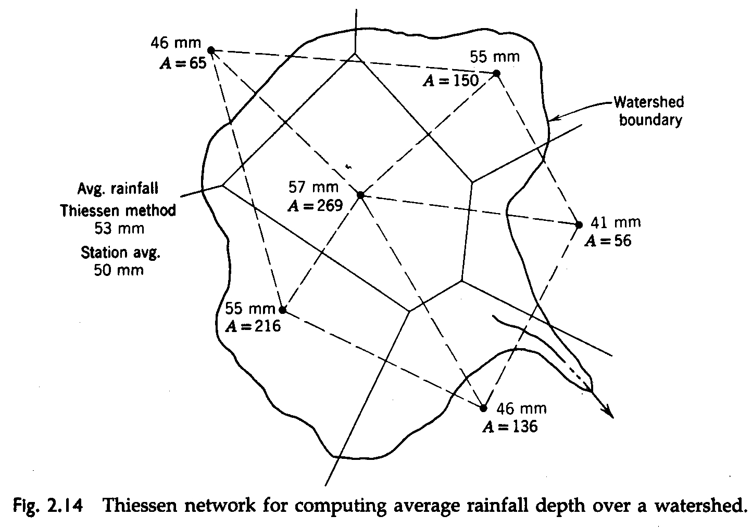

Slide 33
Isohyetal method
Steps
  Construct isohyets (rainfall contours)
  Compute area between each pair of adjacent isohyets (A_{i})
  Compute average precipitation for each pair of adjacent isohyets (p_{i})
  Compute areal average using the following formula
10
20
P₁
A₁=5 , p₁ = 5
A₂=18 , p₂ = 15
P₂
A₃=12 , p₃ = 25
P₃
30
A₄=12 , p₃ = 35

Slide 34
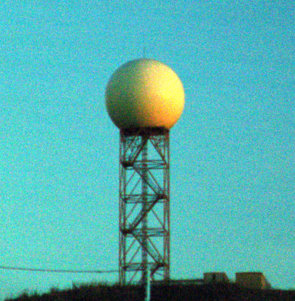

NEXRAD
NEXt generation RADar: is a doppler radar used for obtaining weather information
A signal is emitted from the radar which returns after striking a rainfall drop
Returned signals from the radar are analyzed to compute the rainfall intensity and integrated over time to get the precipitation
NEXRAD Tower
http://radar.weather.gov/radar.php?rid=twx&product=N0R&overlay=11101111&loop=no

Slide 35
Precipitation Data Analysis
Intensity (mm/hr)
Duration (time)
Frequency (time)

Slide 36
Hydrologic Frequency Analysis
Many statistical methods have been used for precipitation analysis.
Connect discrete precipitation event analyses to design storm prediction.
Used for predicting storms of specific frequency and duration for a given location.

Slide 37
Hydrologic Frequency Analysis
T = 100/P
Where T = return period in years,
P = probability in percent that an observed event in a given year is equal to or greater than a given event.

Slide 38
Return Period
The return period (reoccurrence interval) is the period within which the depth of precipitation for a specified duration will be equaled or exceeded once on the average
Example:
  The 100 yr-24 hr precipitation depth for Manhattan, KS is 7.5 inches.
  Thus, Manhattan receives 7.5 inches of precipitation within a 24 hr period on average once every 100 years over many 100 year periods.

Slide 39

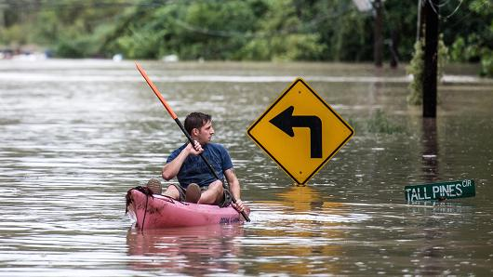
'1,000-year' flood: Weather hyperbole or hard science?
http://www.cnn.com/videos/weather/2015/10/04/south-carolina-flood-gov-nikki-haley-sot.wis

Slide 40
Example
What is the probability that an event with a 10 year return period will occur in any given year?
P = 100/T = 100/10 = 10%
The probability of occurrence for a precipitation event is 40%. How often do expect this event?
T = 100/P = 100/40 = 2.5 years

Slide 41
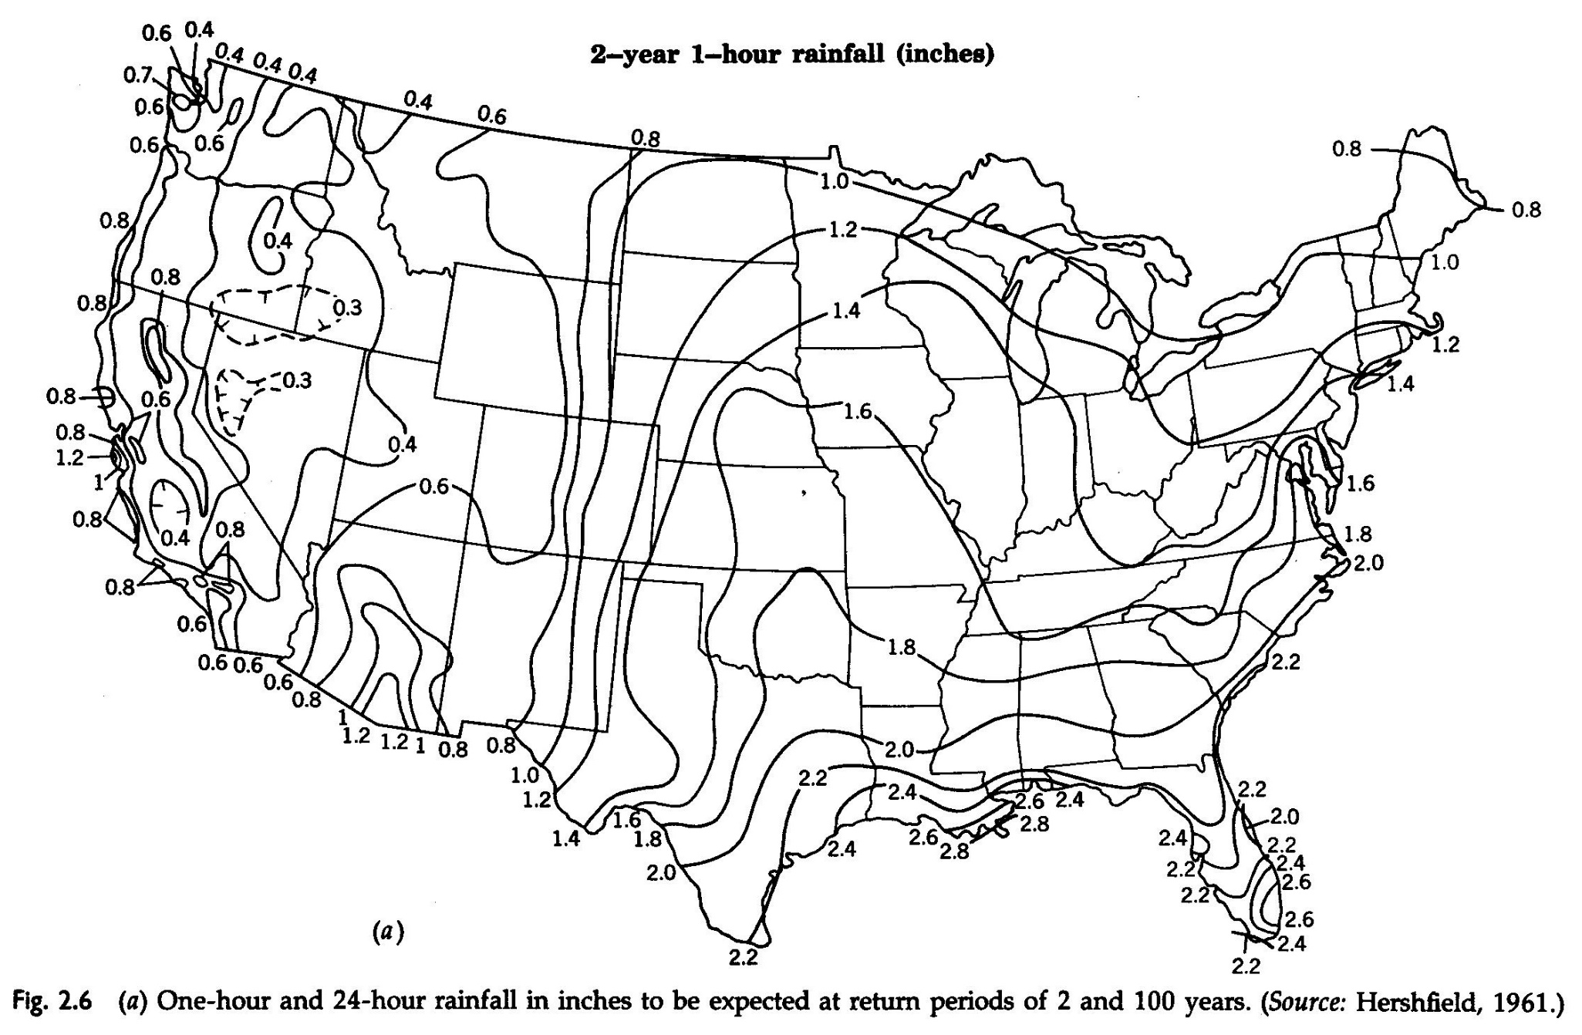

Slide 42
United States Resources
www.weather.gov
http://hdsc.nws.noaa.gov/hdsc/pfds/
http://www.ncdc.noaa.gov/
https://www.ksre.ksu.edu/wdl/

